Slide 1

Analysis of Ed Sheeran's Lyrics
Exploring lyrical themes, sentiment, and trends through data analysis.
Team Members:
Ansh Baheti
Jatin Bisen
Pushkar Gupta and
Divyansh Choudhary

Slide 2

Project Overview
Primary Objectives
Analyze song lyrics to uncover common words, themes, and sentiment patterns.
Using natural language processing, this project aims to identify trends and emotional nuances throughout Ed Sheeran’s broad catalog, enhancing understanding of his style and audience connection.
Structural Insights
Investigate lyric length, structure, and release patterns over the years.
By assessing changes in lyric complexity and song release frequency, we aim to reveal key aspects of Ed Sheeran's evolving musical journey and influences.

Slide 3
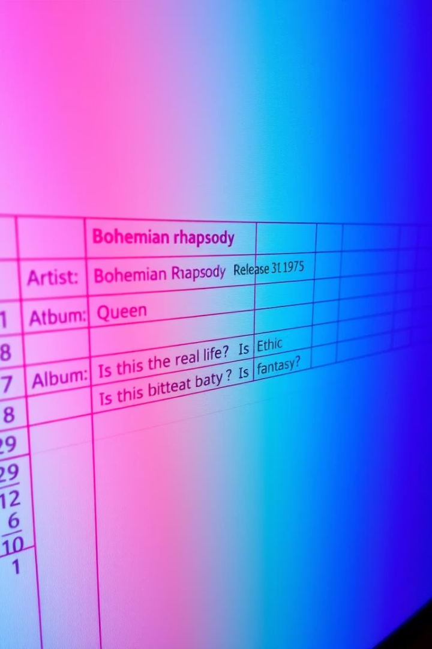
Data Set Overview
Total Songs Analyzed
Over 150 songs spanning Ed Sheeran's discography
Data Size
Content Details
296 songs analyzed, with lyrics for 294 songs.
Includes title, album, year, release date, and full lyrics.
Career Scope
Covers multiple albums spanning Ed Sheeran's career.

Slide 4

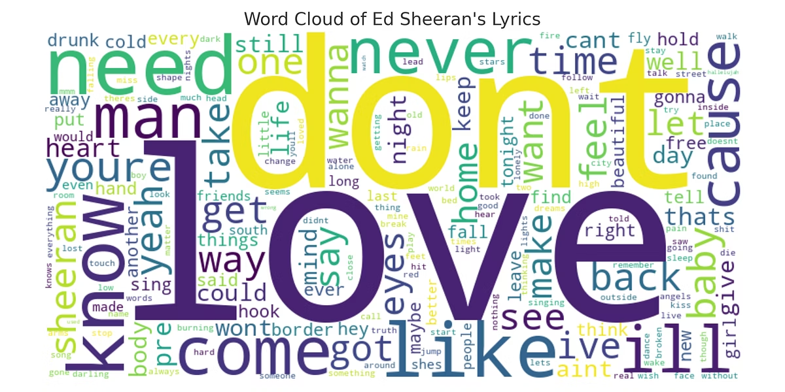
Word Cloud of Lyrics
The word cloud reveals frequently used emotional and personal words.
Words like 'love,' 'know,' and 'heart' dominate the lyrical landscape.

Slide 5


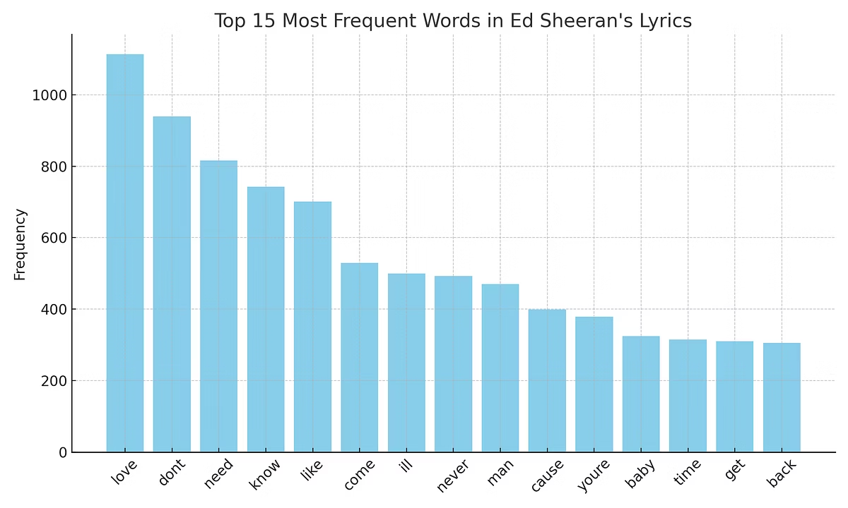

Most Frequent Words
Top Words
Besides themes of love, words expressing emotion and personal reflection are common throughout Ed Sheeran's lyrics. These include words like "heart," "feel," and "stay," which help convey intimate and heartfelt stories.
This recurring vocabulary highlights the introspective and emotional nature of his songwriting, resonating with listeners on a personal level.
Language Style
Ed Sheeran employs simple, relatable vocabulary that enhances the emotional connection with his audience. The use of everyday words and phrases allows listeners to easily understand and relate to the lyrics.
This straightforward language style helps to communicate complex emotions in an accessible way, making his songs widely appealing and memorable.

Slide 6

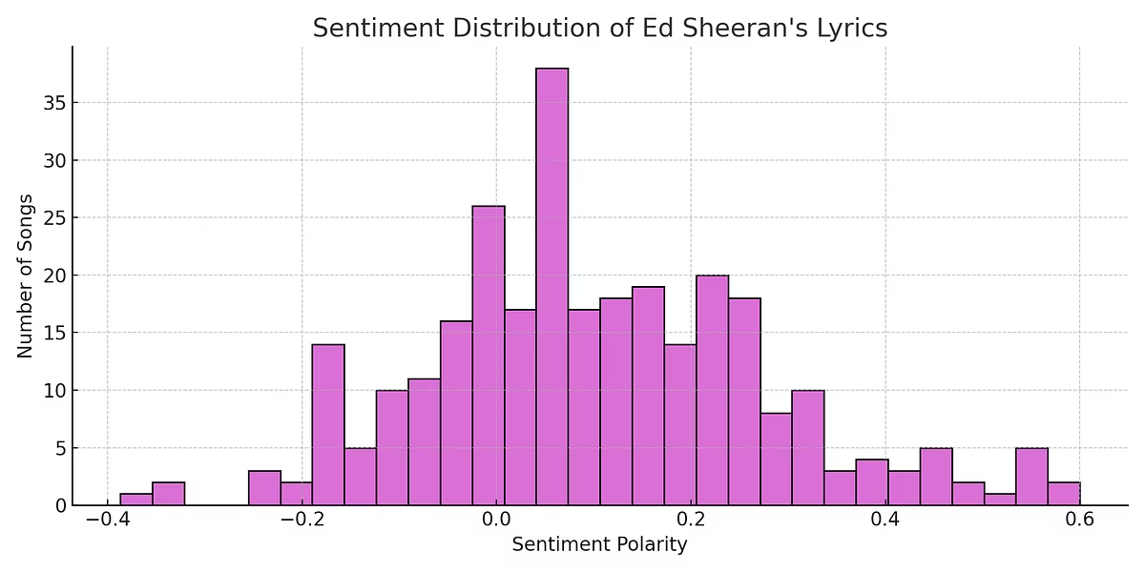
Sentiment Analysis
Positive Sentiment
Most lyrics reflect a positive and hopeful tone.
Emotional Range
Touches on themes of love, self-awareness, and resilience.

Slide 7
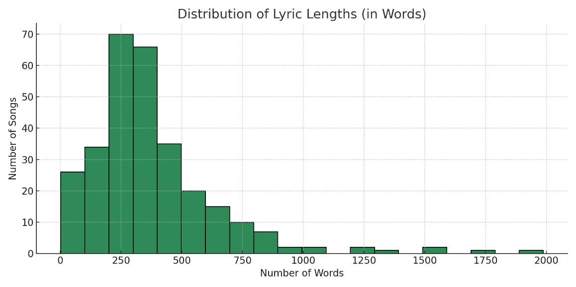
Lyric Length Distribution
1
Typical Length
Most songs cluster around 150-250 words.
2
Consistency
Stable lyric length aligns with modern pop song structures.

Slide 8
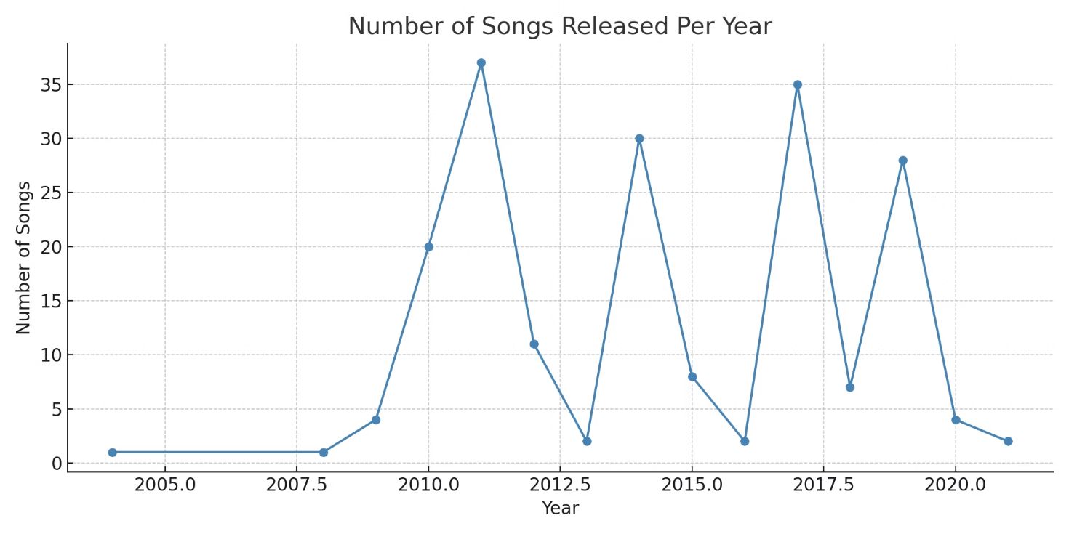
Songs Released Per Year
Release Trends
Career Highlights
Song output peaks coincide with new album releases and creative bursts.
Periods of high productivity reflect artistic evolution and public demand.

Slide 9

Interesting Insights
Emotional Language
Frequent use of words like 'love,' 'know,' and 'heart' shows personal storytelling.
Positive Tone
Lyrics generally maintain a positive sentiment with emotional depth.
Creative Peaks
Highest output during album releases, demonstrating focused creativity.
Lyric Structure
Lengths align with pop norms, supporting catchy, radio-friendly songs.

Slide 10
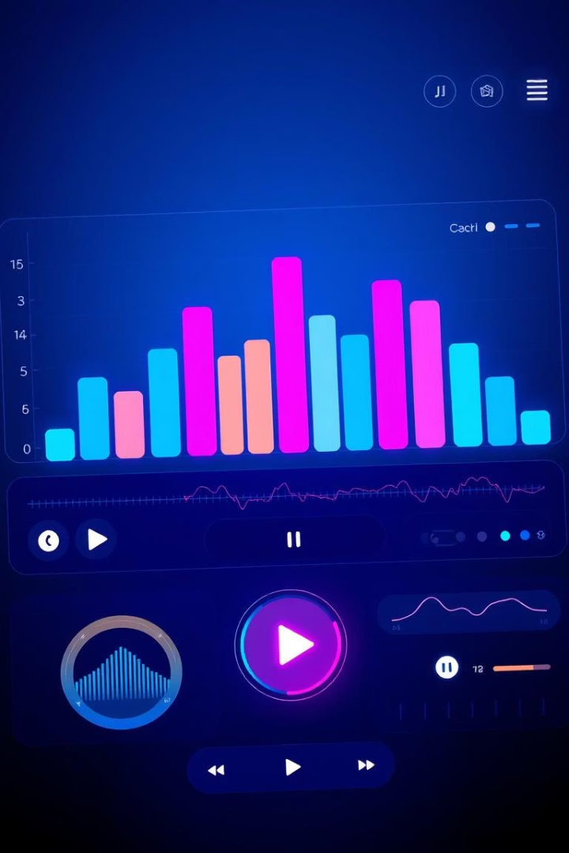
Conclusion
Patterns & Trends
Our analysis reveals consistent patterns in Ed Sheeran's lyrics, including repeated word usage centered around emotional and personal themes. The sentiment across his songs tends to be positive and hopeful, which resonates well with his audience. Additionally, we observed bursts of creative output that align with album releases, highlighting periods of heightened productivity and artistic evolution.
Next Steps
To deepen insights, we recommend expanding this analysis to include a broader range of artists and albums. Comparative studies could uncover unique stylistic differences and common trends across genres or periods. This approach will provide a more comprehensive understanding of lyrical themes and their impact on listeners.

